Slide 1
Sentiment Analysis Based on Reviews
Notes:
TO ADD NEW SLIDE LAYOUTS: Make sure you have the ‘Home’ tab selected at the top of the PowerPoint screen and click the down facing arrow to the right on the ‘New Slide’ button that is located in the second section. Look through the layouts shown and click on the one you would like to work on.
TO REMOVE SLIDES: Select the slide you would like to remove in the vertical window on the left side of the screen then hit the ‘Delete’ (on Mac) or the ‘Backspace’ (on PC).
TO REMOVE PAGE NUMBERS: At the top of the PowerPoint screen between ‘Home’ and ‘Design’ click on ’Insert.’ Then in the options bar just below ’Insert’ click on ’Slide Number’ which is in the same section a the ‘Text Box’ and ‘Object.’ Uncheck the box next to ‘Slide Numbers’ and click ‘Apply to All.’
TO ADD PAGE NUMBERS: At the top of the PowerPoint screen between ‘Home’ and ‘Design’ click on ’Insert.’ Then in the options bar just below ’Insert’ click on ’Slide Number’ which is in the same section a the ‘Text Box’ and ‘Object.’ Check the box next to ‘Slide Numbers’ and click ‘Apply to All.’

Slide 2
Group Members
Manish Mondal- Student ID- 700713864
Hardik Bharatkumar Somaiya - Student ID - 700726838

Slide 3
Responsibilities and Contribution in project
Tasks by Hardik
Researched and downloaded yelp dataset.
Configured Google Colab. ta
Model Selection for Sentiment analysis of the reviews.
Presentation Slides
Data Generation for report
Preset.
Tasks by Manish
Uploaded data to Google Drive.
Preprocessing and data cleaning.
Model Validation
Report preparation

Slide 4
Motivation
Ratings are subjective in nature as one person if somewhat likes a product and gives 5 stars
some other person gives five star only when he/she is fully satisfied with the product.
Also one person’s worst rating does not clearly relate with other person’s worst
Hence we need to read actual reviews to understand overall acceptance of a product
Reading all the reviews is a challenging task

Slide 5
Objectives
Classify overall product sentiment based on actual reviews provided by users

Slide 6
Related work
Sentiment analysis has been investigated using below approaches
Document/Sentence/Phrase/Aspect Level
Unsupervised Learning- K Means
Supervised Learning - Logistic Regression , Naive Bayes etc

Slide 7
Problem Statement
Perform Sentiment analysis of Reviews and classify review in four classes.
Slightly Positive
Slightly Negative
Positive
Negative

Slide 8
Proposed Solution
Data gathering
Preprocessing
Exploratory Data Analysis
Feature Extraction
Machine Learning
Model Evaluation

Slide 9
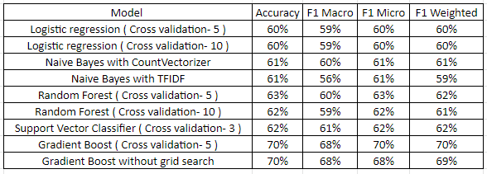
Results
We performed the testing on 9 combinations of machine learning algorithms like Logistic regression, Naive Bayes, Random Forest, Support Vector Classifier and Gradient Boost Classifier with Cross validation values of 3,5 and 10.
We were able to improve the accuracy from 60% of Logistic Regression to 70% using gradient boost classifier.

Slide 10
References
For the dataset
https://www.yelp.com/dataset/documentation/main
NLTK documentation
Twitter sentiment analysis project
Medium.com website

Slide 11
Thank you

